Slide 1

Convolutional Neural Networks in TensorFlow
Notes:
‹#›

Slide 2
Objectives
Understand CNN in TensorFlow
Implement the CNN model for classification
Convolutional Neural Networks in TensorFlow
‹#›

Slide 3
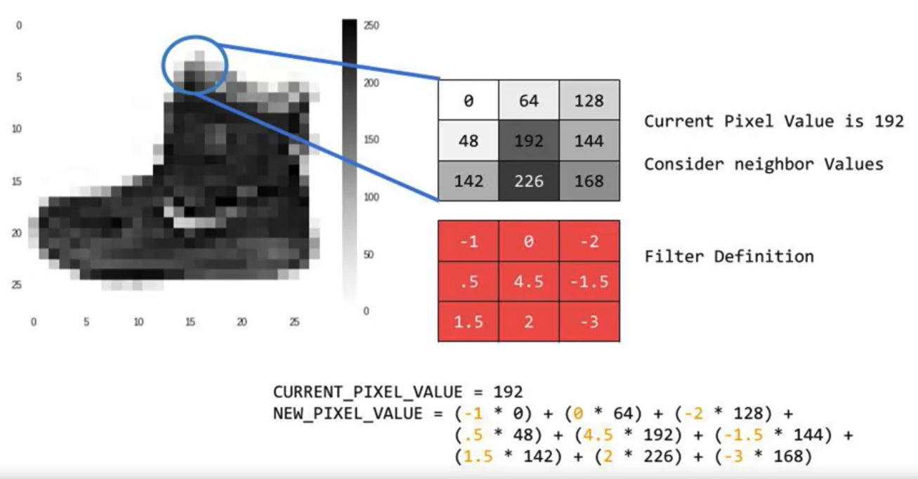
Convolutions
Change the image in such a way that certain features in the image get emphasized
Convolutional Neural Networks in TensorFlow
‹#›
Notes:
‹#›

Slide 4
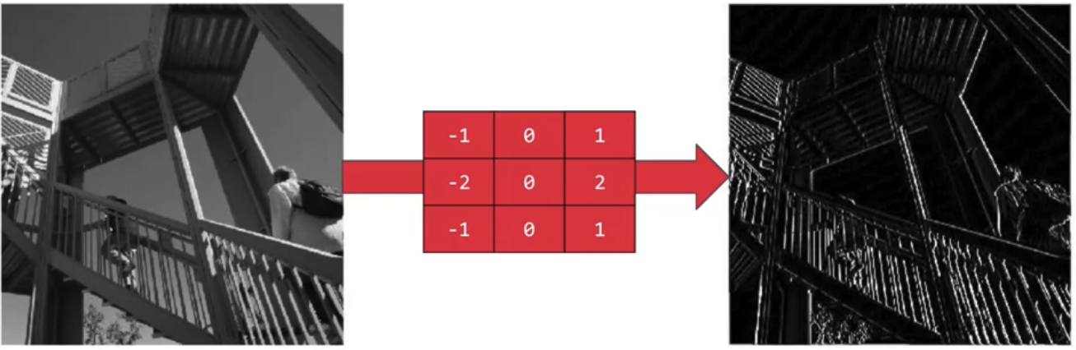
Convolutions
This filter, then the vertical lines in the image really pop out
Convolutional Neural Networks in TensorFlow
‹#›
Notes:
‹#›

Slide 5
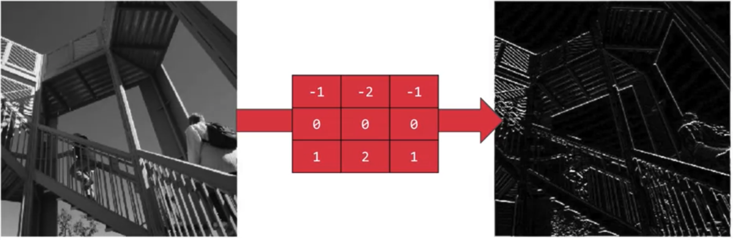
Convolutions
This filter, the horizontal lines pop out
Convolutional Neural Networks in TensorFlow
‹#›
Notes:
‹#›

Slide 6
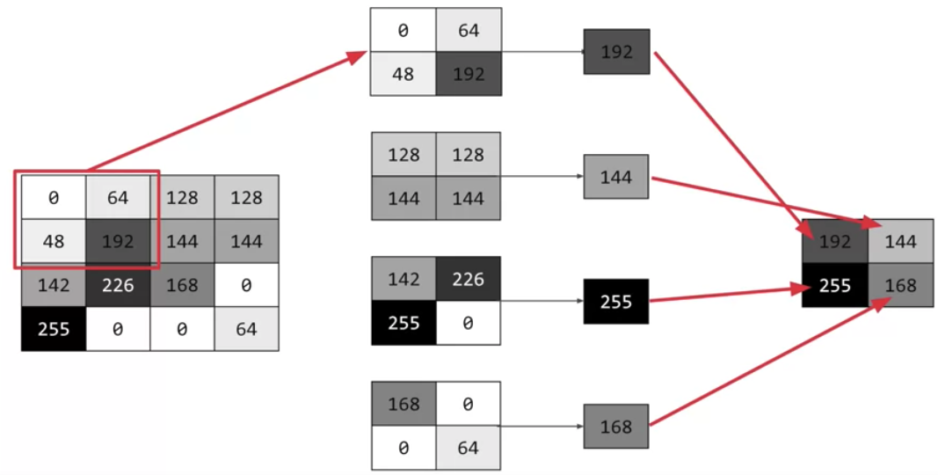
Pooling
Pooling is a way of compressing an image
What kind of this pooling?
Convolutional Neural Networks in TensorFlow
‹#›
Notes:
‹#›

Slide 7
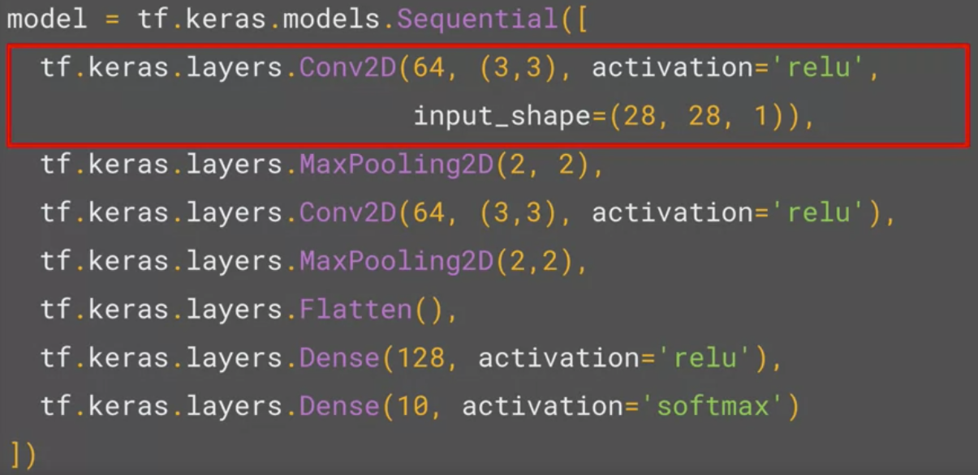
Implementing Convolutional layers
We're asking keras to generate 64 filters.
These filters are 3 by 3
Their activation is relu→ the negative values will be thrown way
The input shape is as before, the 28 by 28.
That extra 1 just means that we are tallying using a single byte for color depth.
Convolutional Neural Networks in TensorFlow
‹#›
Notes:
‹#›

Slide 8
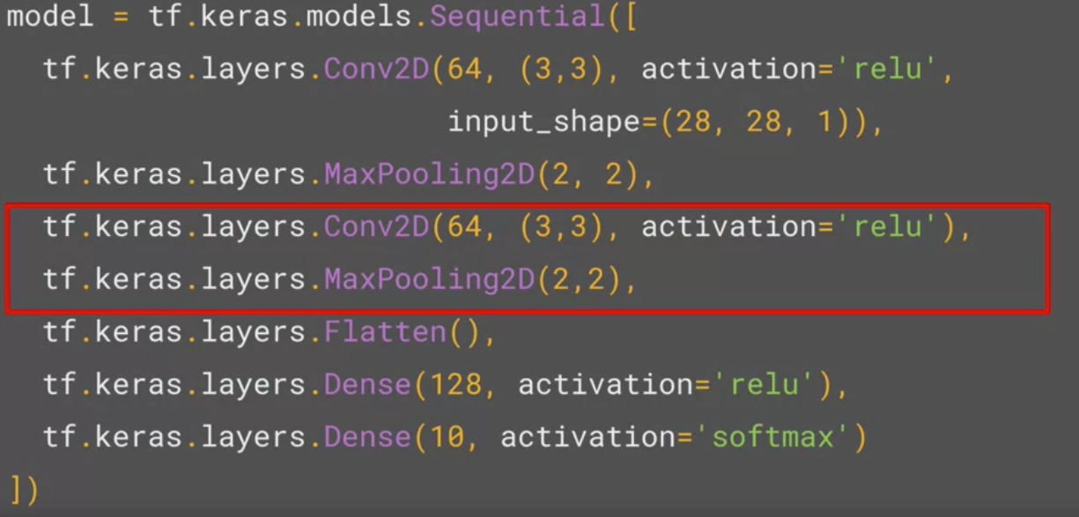
Implementing Pooling layers
Max Pooling: two-by-two pool, so for every four pixels, the biggest one will survive
Convolutional Neural Networks in TensorFlow
‹#›
Notes:
‹#›

Slide 9
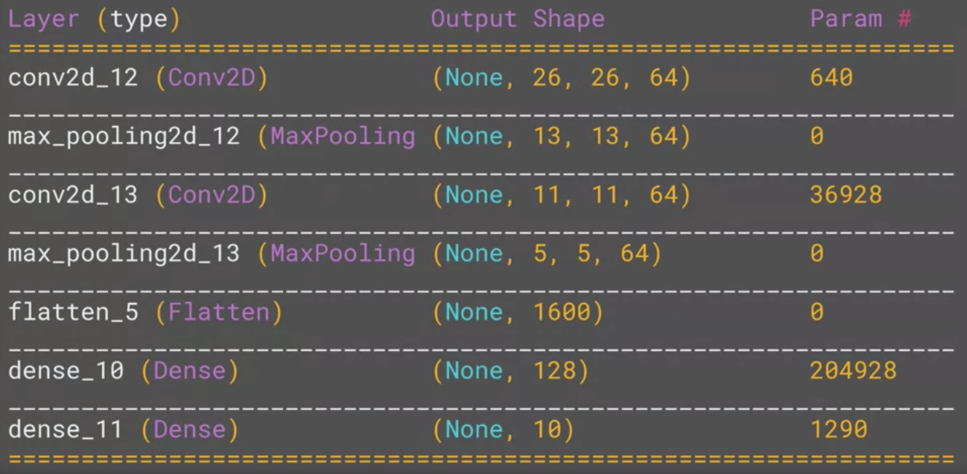
Model.summary()
Inspect the layers of the model, and see the journey of the image through the convolutions
Convolutional Neural Networks in TensorFlow
‹#›
Notes:
‹#›

Slide 10
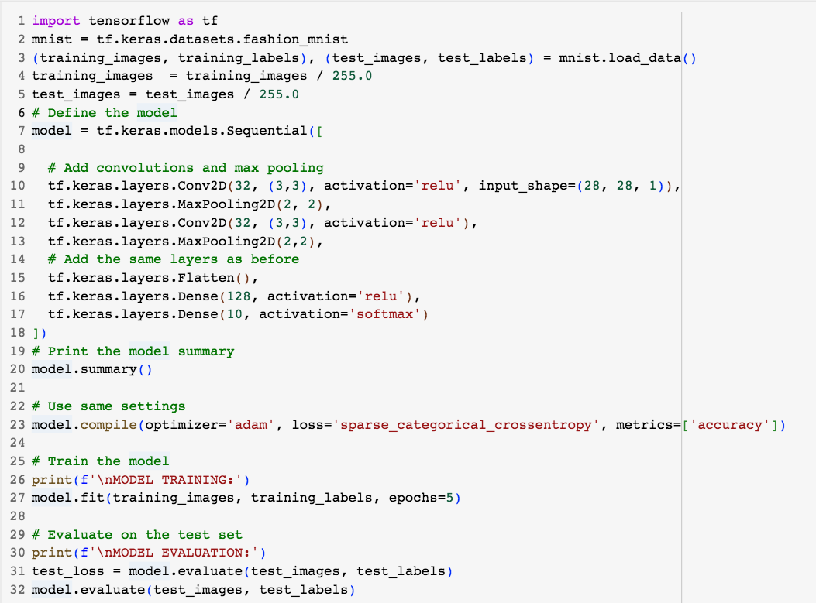
Fashion classifier with convolutions
Convolutional Neural Networks in TensorFlow
‹#›
Notes:
‹#›

Slide 11
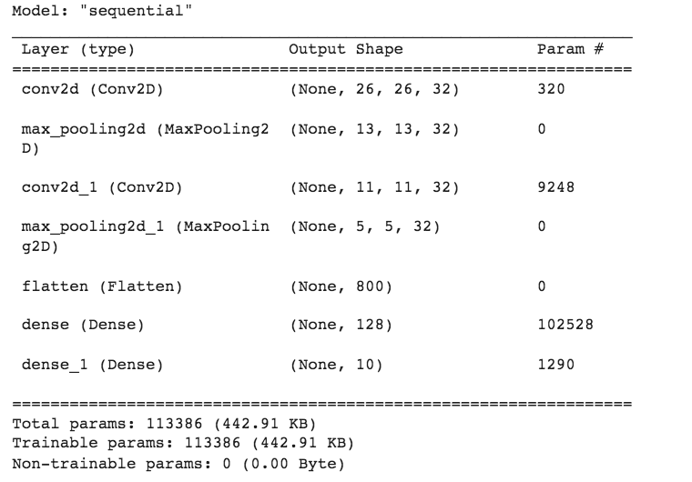
Fashion classifier with convolutions
Convolutional Neural Networks in TensorFlow
‹#›
Notes:
‹#›

Slide 12
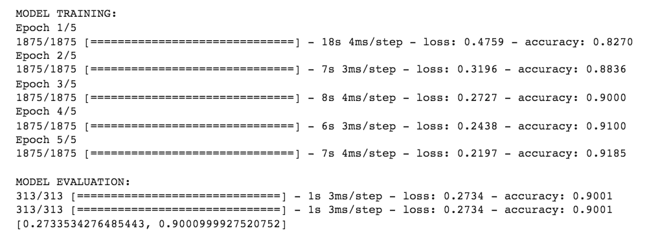
Fashion classifier with convolutions
Convolutional Neural Networks in TensorFlow
‹#›
Notes:
‹#›

Slide 13
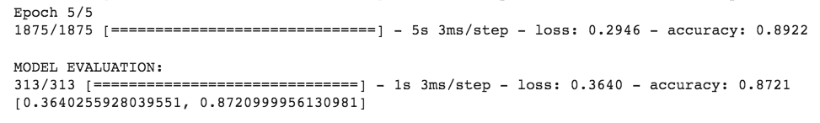
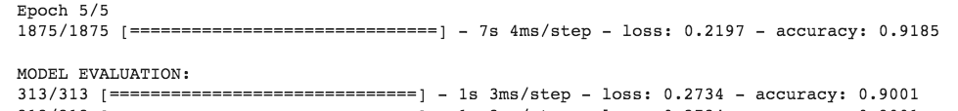
Neural network & Convolutinal
Neural Network
Convolutional Neural Network
Discuss and give your opinions.
Convolutional Neural Networks in TensorFlow
‹#›
Notes:
‹#›

Slide 14
Summary
Understand CNN in TensorFlow
Implement the CNN model for classification
Convolutional Neural Networks in TensorFlow
‹#›

Slide 15
Q & A
Convolutional Neural Networks in TensorFlow
‹#›

